Slide 1
Machine Learning Supervised Learning - Bayesian Classifier
Instructor: Zainab Yousuf

Slide 2
Content
Bayesian Classifier.
Classification using Bayesian classifier over Discrete Data

Slide 3
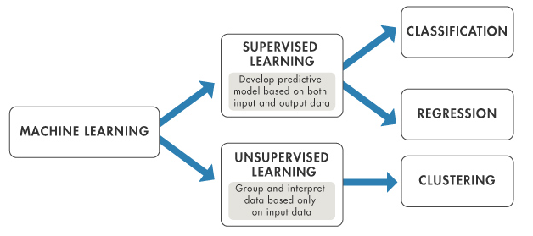
Machine Learning
Supervised and unsupervised learning are most common types of ML
To predict categorical responses
To predict continuous responses
To group the data on the basis of input features

Slide 4
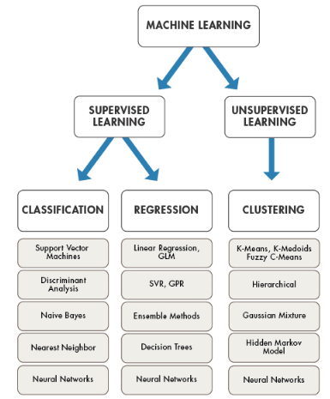
Naïve Bayes
Linear Regression
K-mean
Neural Network
Neural Network
Hierarchal
Nearest Neighbor
Decision Tree
Hidden Markov
Support Vector Machine
SVR
Gaussian Mixture
Discriminative Analysis
Ensemble Methods
Neural Network

Slide 5

Bayesian Classifier
Bayesian classifiers are statistical classifiers, and are based on Bayes theorem
It calculates the probability that a given sample belongs to a particular class
Bayesian learning algorithms are among the most practical approaches to certain types of learning problems.
Its results are comparable to the performance of other classifiers, such as decision tree and neural networks in many cases

Slide 6
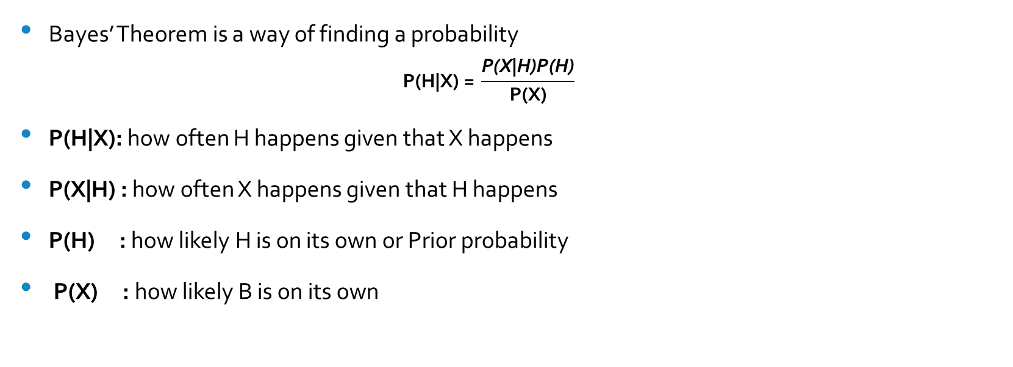
Bayes Theorem
Bayes’ Theorem is a way of finding a probability
$$\text{P}\text{(}\text{H}\text{|}\text{X}\text{) = }\frac{\text{P}\text{(}\text{X}\text{|}\text{H}\text{)}\text{P}\text{(}\text{H}\text{)}}{\text{P}\text{(}\text{X}\text{)}}$$
P(H|X): how often H happens given that X happens
P(X|H) : how often X happens given that H happens
P(H) : how likely H is on its own or Prior probability
P(X) : how likely B is on its own

Slide 7

Bayes Theorem
Let X be a data sample (e.g. red and round fruit)
Let H be a Hypothesis (e.g. X is an apple)
For classification using Bayes theorem, we need to determine
Posterior probability P(H|X)
The probability that the hypothesis H holds given the observed data sample X
Prior probability P(H)
The probability that any given data sample is an apple, regardless of how the data sample looks
It is independent of the data sample X

Slide 8
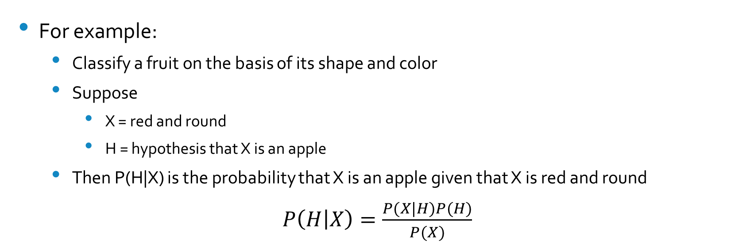
Bayes Theorem
For example:
Classify a fruit on the basis of its shape and color
Suppose
X = red and round
H = hypothesis that X is an apple
Then P(H|X) is the probability that X is an apple given that X is red and round
$P\left(H | X\right)=\frac{P(X|H)P(H)}{P(X)}$

Slide 9
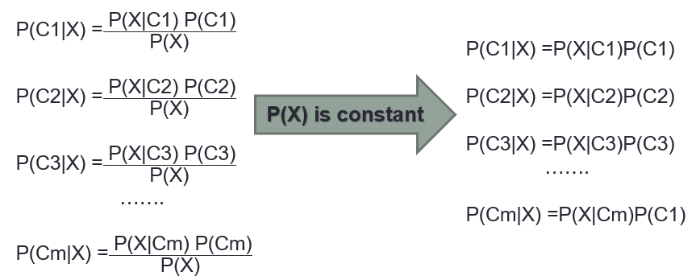
Bayesian Classification
The classifier will predict that X belongs to the class that is having the highest posterior probability
Based on the Bayes theorem, we need to find then posterior probability for each class {C1,C2,C3…..Cm}

Slide 10
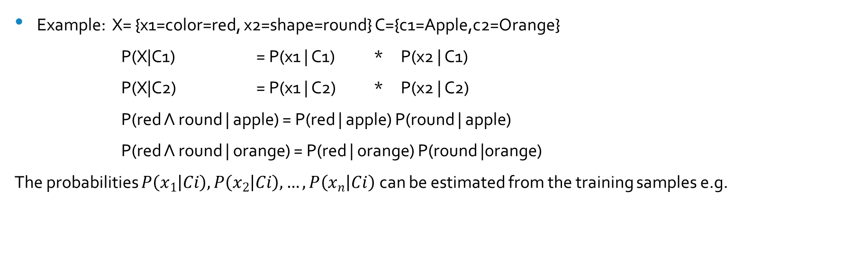

Bayesian Classification
The class prior probability P(Ci) may be estimated as
P(Ci) = number of samples of class Ci / total sample
The P(X|Ci) can be calculated as:
$$P\left(X | C_{i}\right)=\prod_{k=1}^{n}{P(X_{k}|C_{i}) }$$
$$P\left(X | C_{i}\right)=P\left(x_{1} | C_{i}\right)∗P\left(x_{2} | C_{i}\right)∗P\left(x | C_{i}\right)……P\left(x_{n} | C_{i}\right)$$
Example: X= {x1=color=red, x2=shape=round} C={c1=Apple,c2=Orange}
P(X|C1) = P(x1 | C1) * P(x2 | C1)
P(X|C2) = P(x1 | C2) * P(x2 | C2)
P(red Λ round | apple) = P(red | apple) P(round | apple)
P(red Λ round | orange) = P(red | orange) P(round |orange)
The probabilities $P\left(x_{1} | Ci\right), P\left(x_{2} | Ci\right), …, P\left(x_{n} | Ci\right)$ can be estimated from the training samples e.g.

Slide 11
Example
Given the historical data of customers who bought computer, classify a new customer whether he will buy a computer or not?

Slide 12
Training Set or Historical Data
S.No | Age | Income | Student | Credit rating | Class: Buy Computer
1 | <30 | High | No | Fair | No
2 | <30 | High | No | Excellent | No
3 | 30-40 | High | No | Fair | Yes
4 | >40 | Medium | No | Fair | Yes
5 | >40 | Low | Yes | Fair | Yes
6 | >40 | Low | Yes | Excellent | No
7 | 30-40 | Low | Yes | Excellent | Yes
8 | <30 | Medium | No | Fair | No
9 | <30 | Low | Yes | Fair | Yes
10 | >40 | Medium | Yes | Fair | Yes
11 | <30 | Medium | Yes | Excellent | Yes
12 | 30-40 | Medium | No | Excellent | Yes
13 | 30-40 | High | Yes | Fair | Yes
14 | >40 | Medium | No | Excellent | No

Slide 13
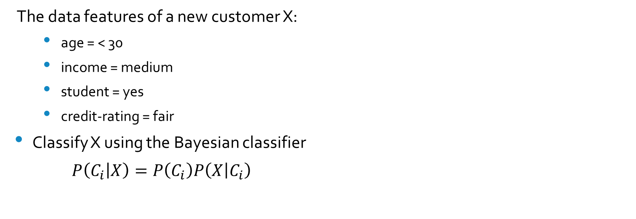
Example (Cont..)
The data features of a new customer X:
age = < 30
income = medium
student = yes
credit-rating = fair
Classify X using the Bayesian classifier
$P\left(C_{i} | X\right)=P\left(C_{i}\right)P\left(X | C_{i}\right)$
(Simplified at slide No. 9)

Slide 14
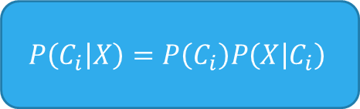
Example (Cont..)
$$P\left(C_{i} | X\right)=P\left(C_{i}\right)P\left(X | C_{i}\right)$$
There are two classes (C1 & C2) so, we need to find the prior probability P(Ci) for both.
P(C1) = P(Buy Computer = yes)
= samples with class C1/ total samples
= 9/14 = 0.643
P(C2) =P(Buy Computer = no)
= samples with class C2/ total samples
= 5/14 = 0.357

Slide 15
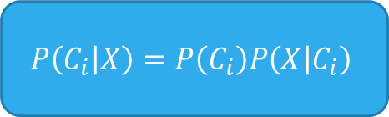
Example (Cont..)
$$P\left(C_{i} | X\right)=P\left(C_{i}\right)P\left(X | C_{i}\right)$$
To compute P(X|Ci), we need to compute the following conditional probabilities for each attribute first,
P(age=“<30” | Buy Computer = Yes)
P(income=“medium” | Buy Computer = Yes)
P(Student=“Yes” | Buy Computer = Yes)
P(Credit rating=“Fair” | Buy Computer = Yes)
P(X|Buy Computer=Yes) =?
P(age=“<30” | Buy Computer = No)
P(income=“medium” | Buy Computer = No)
P(Student=“Yes” | Buy Computer = No)
P(Credit rating=“Fair” | Buy Computer = No)
P(X|Buy Computer=No) =?
P(X|C1)
P(X|C2)

Slide 16

To compute P(x1|Ci):
P(age=“<30” | Buy Computer = Yes)
$\text{P}\text{(}\text{X}\text{|}\text{Y}\text{)}=\frac{\text{P}\text{(}\text{X} \text{∩} \text{Y}\text{)}}{\text{P}\text{(}\text{X}\text{)}}$
$\frac{\text{P}\text{(}\text{age}\text{=“<30” }\text{and} \text{Buy} \text{Computer}\text{=}\text{Yes}\text{)}}{\text{P}\text{(}\text{age}\text{=“<30”) }}$
$=\frac{(2/9)}{(5/14)}$
P(age=“<30” | Buy Computer = No)
$\text{P}\text{(}\text{X}\text{|}\text{Y}\text{)}=\frac{\text{P}\text{(}\text{X} \text{∩} \text{Y}\text{)}}{\text{P}\text{(}\text{X}\text{)}}$
$\frac{\text{P}\text{(}\text{age}\text{=“<30” }\text{and} \text{Buy} \text{Computer}\text{=}\text{No}\text{)}}{\text{P}\text{(}\text{age}\text{=“<30”) }}$
$=\frac{(3/5)}{(5/14)}$

Slide 17

Example (Cont..)
$$P\left(C_{i} | X\right)=P\left(C_{i}\right)P\left(X | C_{i}\right)$$
To compute P(X|Ci), we need to compute the following conditional probabilities for each attribute first,
P(age=“<30” | Buy Computer = Yes) =2/9=0.222
P(income=“medium” | Buy Computer = Yes) =4/9=0.444
P(Student=“Yes” | Buy Computer = Yes) =6/9=0.667
P(Credit rating=“Fair” | Buy Computer = Yes) =6/9=0.667
P(X|Buy Computer=Yes) = 0.222 * 0.444 * 0.667 *0.667= 0.044
P(age=“<30” | Buy Computer = No) =3/5=0.600
P(income=“medium” | Buy Computer = No) =2/5=0.400
P(Student=“Yes” | Buy Computer = No) =1/5=0.200
P(Credit rating=“Fair” | Buy Computer = No) =2/5= 0.400
P(X|Buy Computer=No) = 0.600 * 0.400 * 0.200 * 0.400= 0.019
P(X|C1)
P(X|C2)

Slide 18
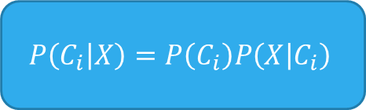
Example (Cont..)
$$P\left(C_{i} | X\right)=P\left(C_{i}\right)P\left(X | C_{i}\right)$$
According to previous calculations (slide 14&17)
P(C1) = P(Buy Computer=Yes) = 0.643
P(X| C1) = P(X|Buy Computer=Yes) = 0.044
P(C2) = P(Buy Computer=No) = 0.357
P(X| C2) = P(X|Buy Computer=No) = 0.019
Now posterior probability P(Ci|X) = P(X|Ci) P(Ci) for each class can be computed as
P(Buy Computer=Yes|X) = P(X|Buy Computer=Yes) P(Buy Computer=Yes)
P(C1|X) = P(X|C1)P(C1)
=0.044 * 0.643= 0.028
P(Buy Computer=No|X) = P(X|Buy Computer=No) P(Buy Computer=No)
P(C2|X) = P(X|C2)P(C2)
=0.019 * 0.357= 0.007
Hence the Bayesian classifier predicts that the student will buy computer.

Slide 19
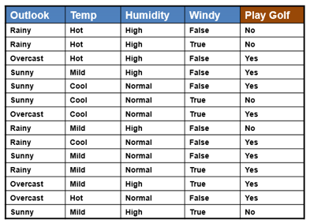
Example: For Practice
Dataset
Classify New data sample X
X={outlook=“Overcast”, Temp=“Mild”, Humidity=“Normal”, Windy=“True”}

Slide 20
Thank You

